Slide 1
Professional Excel Development
Company Salary Analysis

Slide 2
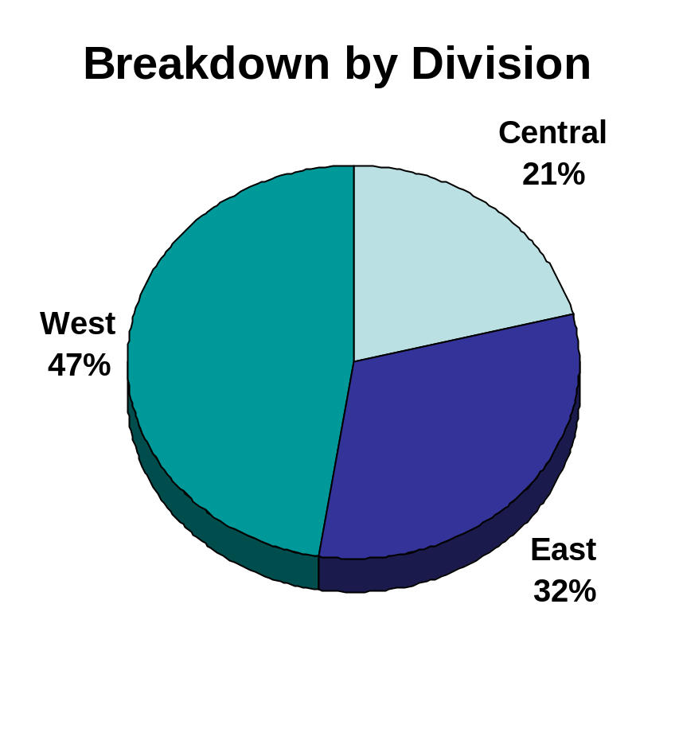
Salary Overview
Total salaries for the Company in 2003 amounted to #SalaryTotal#
This is 15% greater than 2002
The Central Division is growing rapidly

